Slide 1

HOST BEHAVIOR ANALYSIS FOR PROPERTY RENTAL Company
Presented By
Anand Umak [pd13_254]
Mohit Nakade [pd13_254]

Slide 2
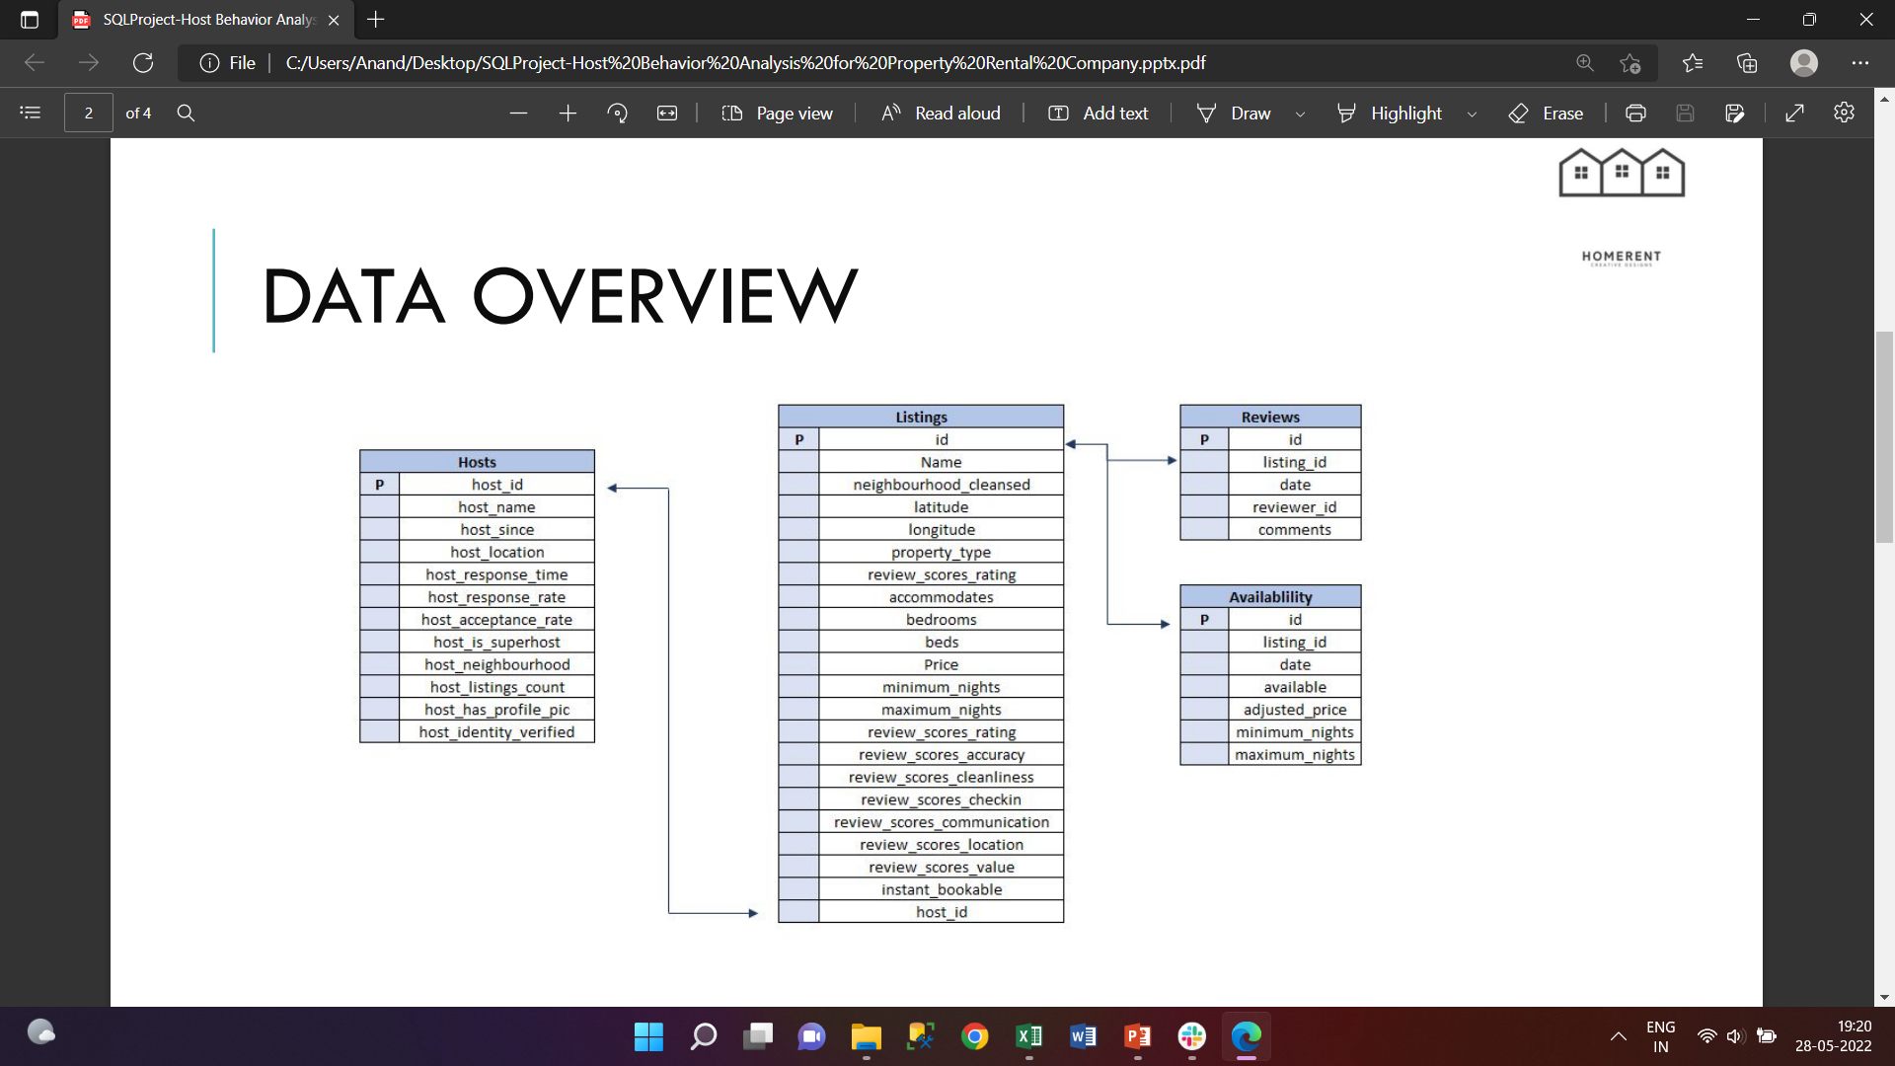

Slide 3
Point Of Analysis
Analysis of Different metrics to draw the distinction between Super Host and Other Hosts such as Acceptance rate, response rate, instant booking, profile picture, identity verified, review scores etc.
Using the above analysis identification of top 3 crucial metrics one needs to maintain to become a Super Host
Analysis of the comments of reviewers vary for listings of Super Hosts vs Other Hosts(Extract words from the comments provided by the reviewers)
Analysis to find do Super Hosts tend to have large property types as compared to Other Hosts
Analysis of the average price and availability of the listings for the upcoming year between Super Hosts and Other Hosts
Analysis of the trends for the two cities for which data has been provided

Slide 4
Introduction
The Host Behaviour Analysis For the Property Rental Company is analysis Between Host who are super host and normal Host and what make them different
The Analysis is of Two Cities host of Country Canada i.e., Toronto And Vancouver.
The primary Insight Are as Follows.
There are total 7616 host and 2353 Super host For Toronto City.
There are total 1898 host and 1228 Super host For Vancouver City.
There Are Total 11346 listing property of Host and 4066 listing property of Super host property For Toronto City.
There Are total 2749 listing property of host and 1779 listing property of super host For Vancouver city.

Slide 5
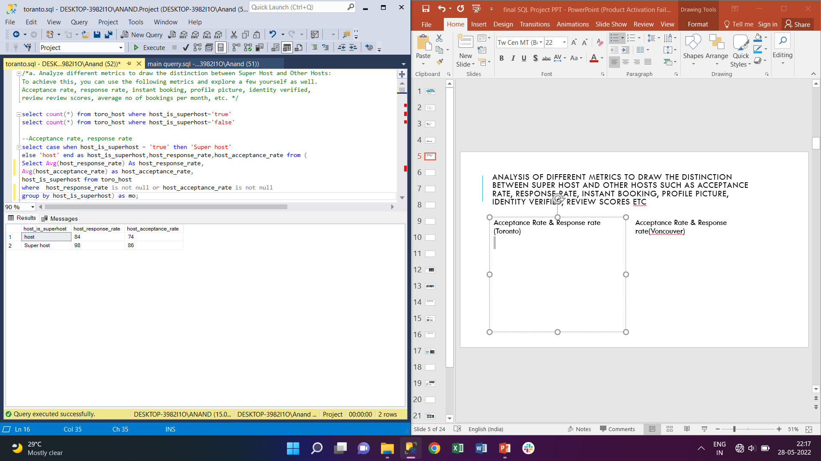
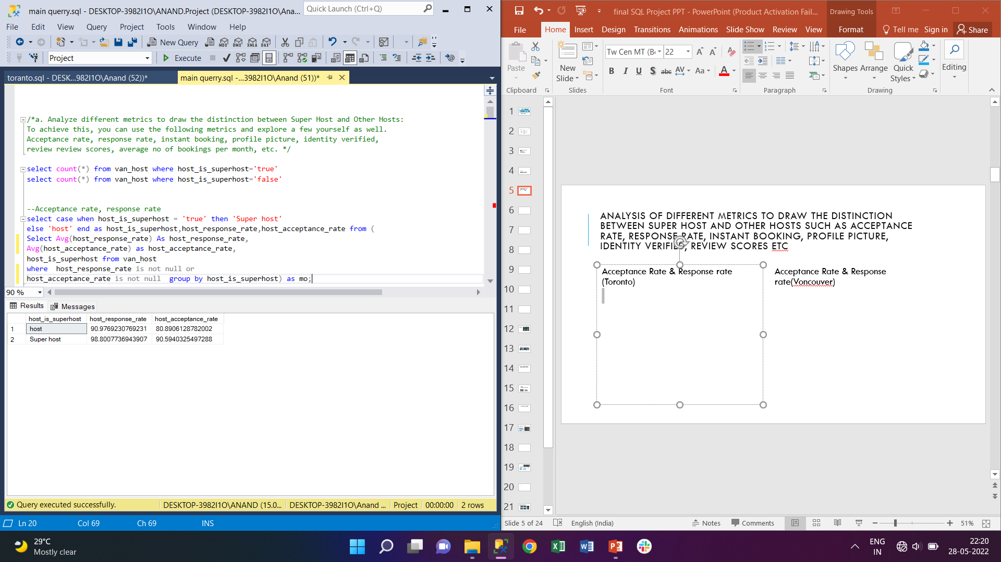
Analysis of Different metrics to draw the distinction between Super Host and Other Hosts such as Acceptance rate, response rate, instant booking, profile picture, identity verified, review scores etc
Acceptance Rate & Response rate (Toronto)
Acceptance Rate & Response rate(Voncouver)

Slide 6
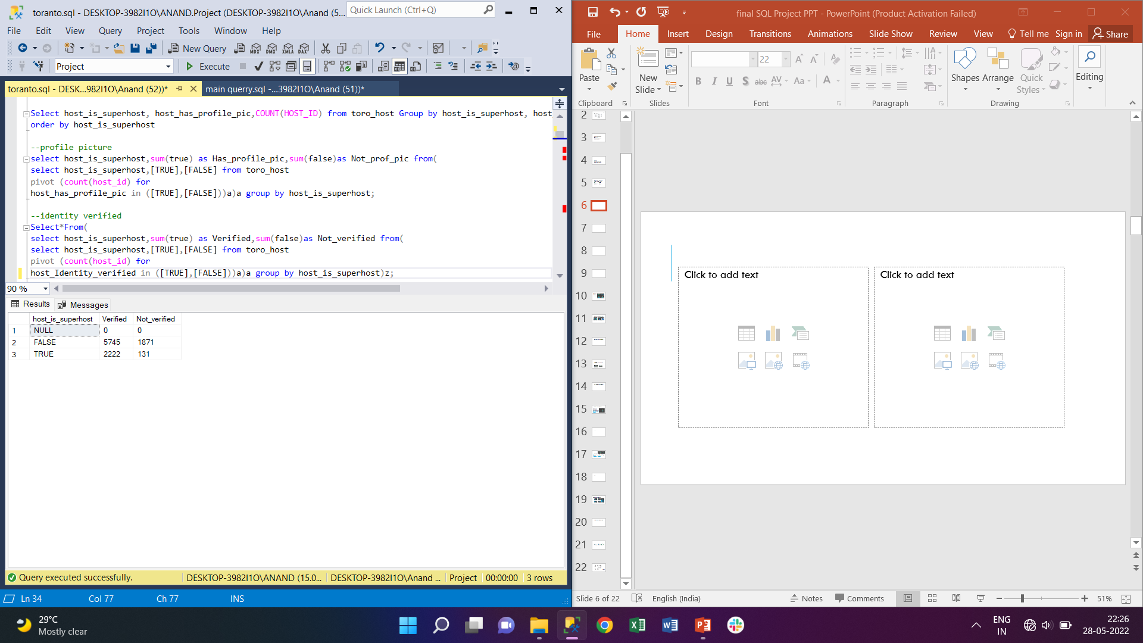
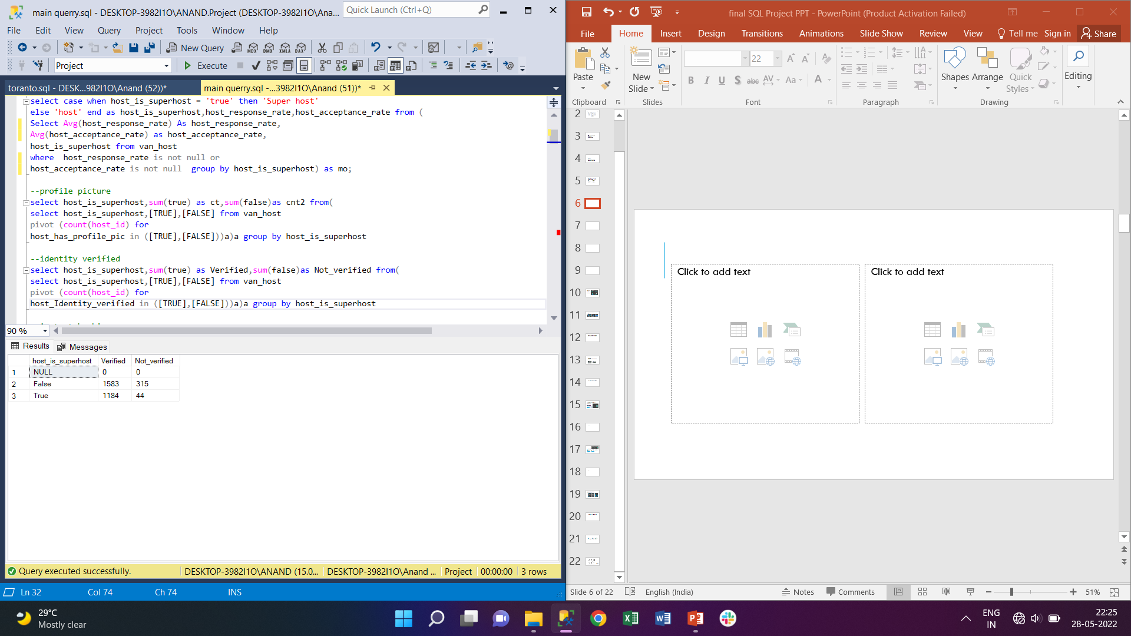
Identity Verified(torronto)
Identity Verified(Vancouver)

Slide 7
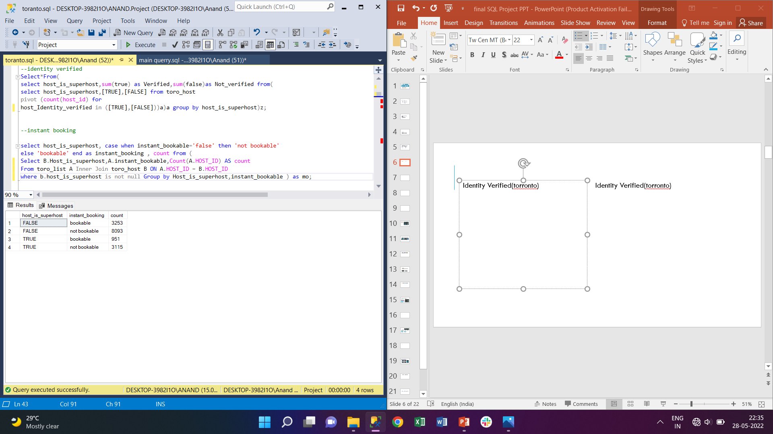
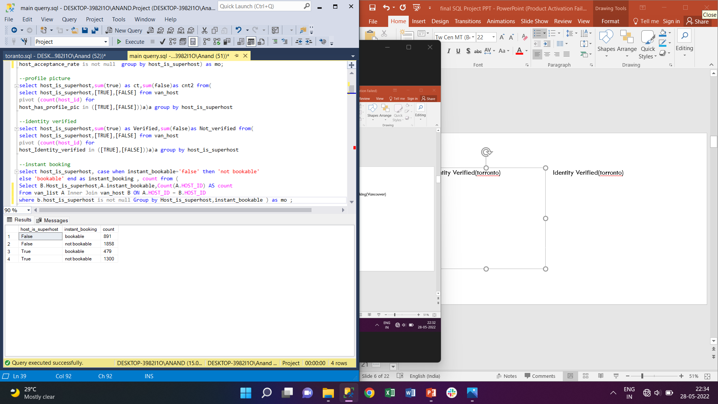
Instant Booking(toronto)
Instant Booking(Vancouver)

Slide 8
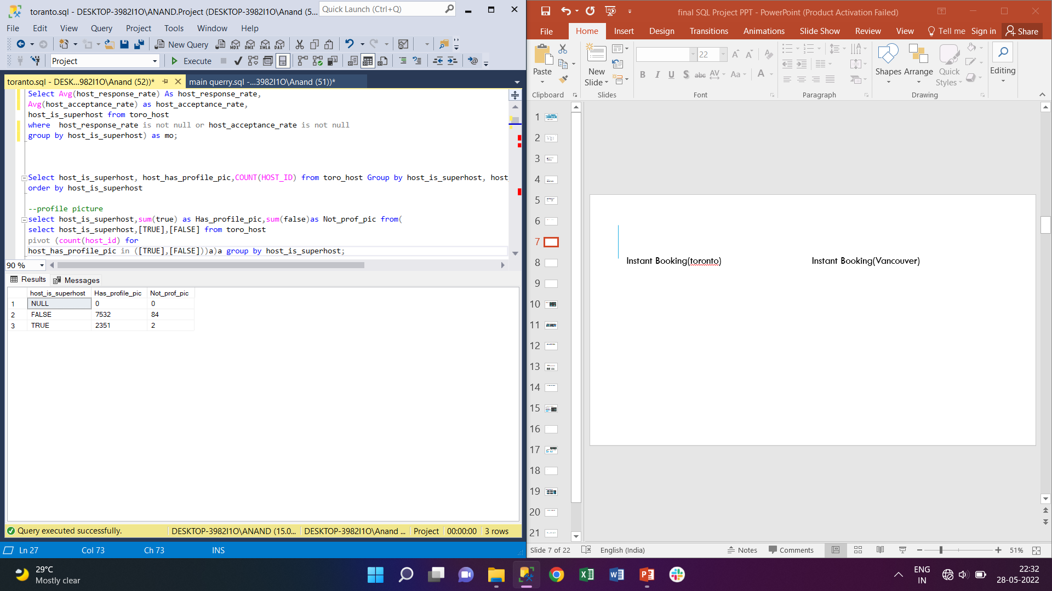
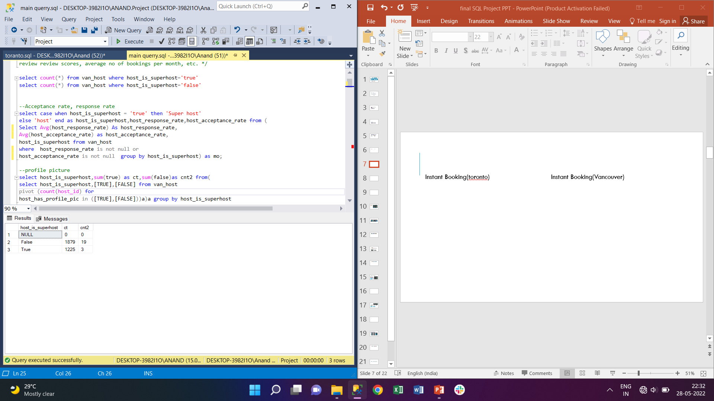
Profile PIC toronto
Profile PIC Vancouver

Slide 9
Graphical Representation
Average Acceptance rate,
Average Response rate,
% of Instant booking Available
% of Profile picture Available
% of Identity verified
% of Average Review scores Value

Slide 10
b. Identification of top 3 crucial metrics one needs to maintain to become a Super Host:
From Previous Analysis the top 3 Crucial Metrics one needed to become a super host should be The Response Rate, Acceptance Rate, Identity Verification and one more the % or Number Of Positive and Negative Comment By Customers.

Slide 11
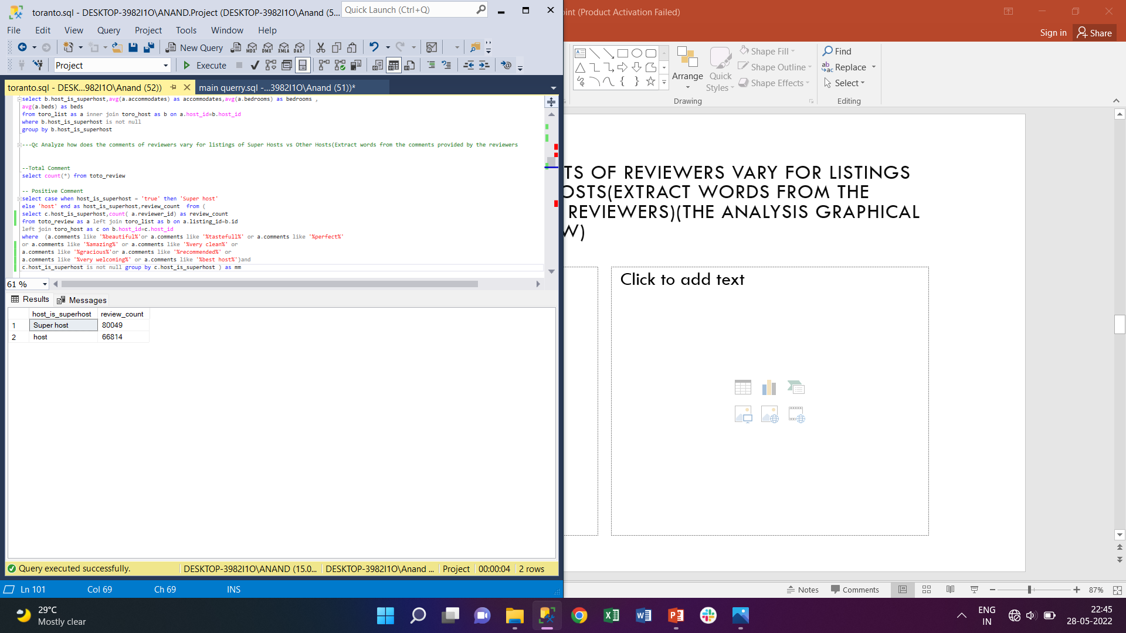
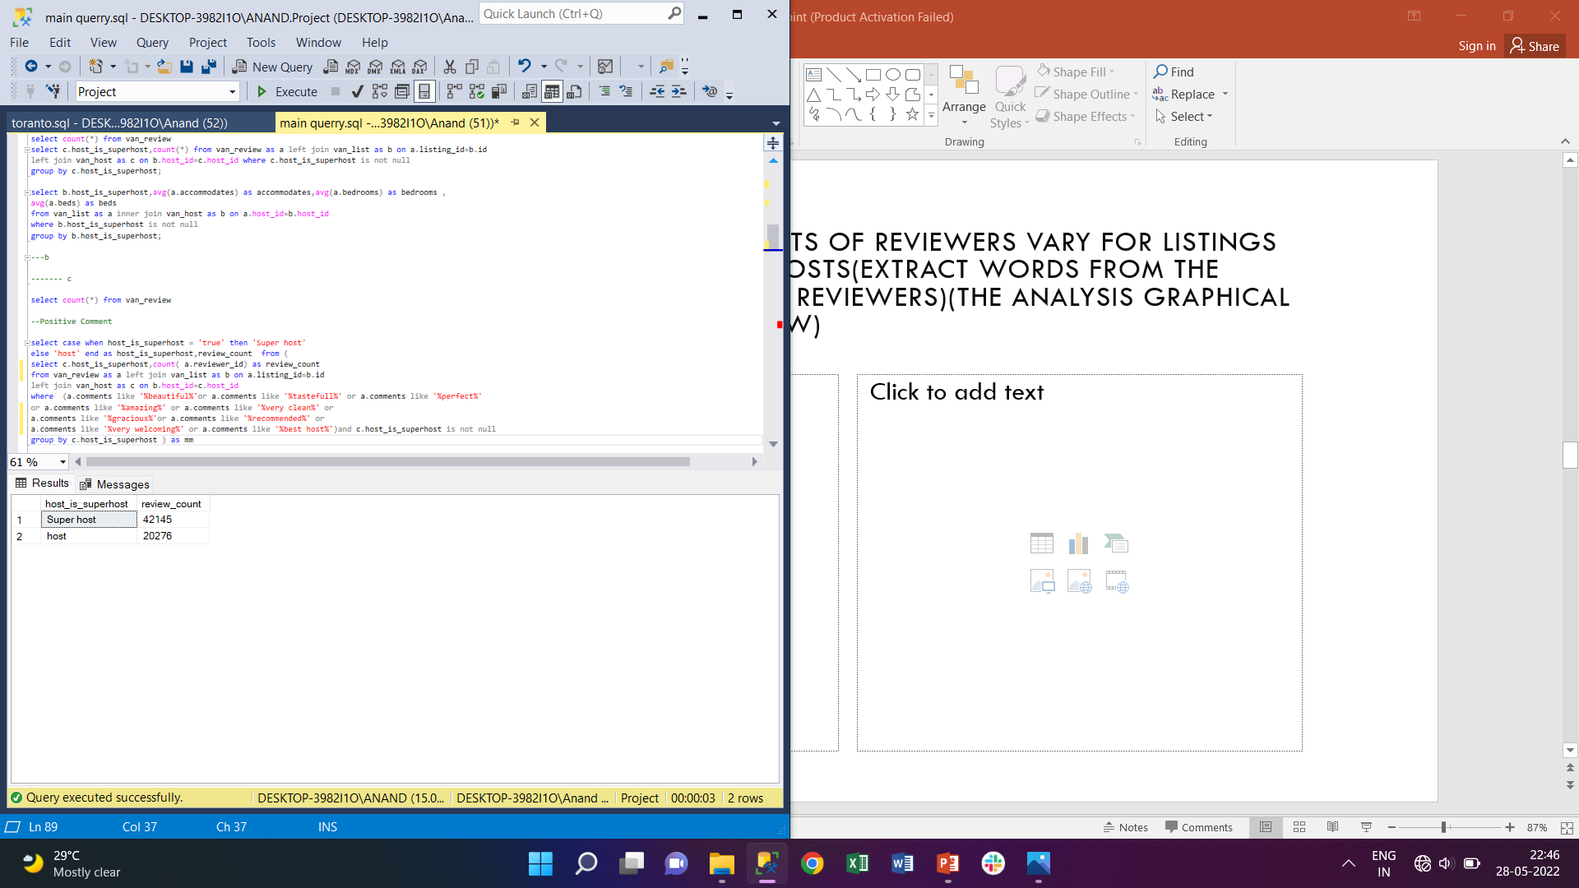
C. Analysis of the comments of reviewers vary for listings of Super Hosts vs Other Hosts(Extract words from the comments provided by the reviewers)(The Analysis Graphical representation given Below)
Positive Comment Toronto
Positive Comment Vancouver

Slide 12
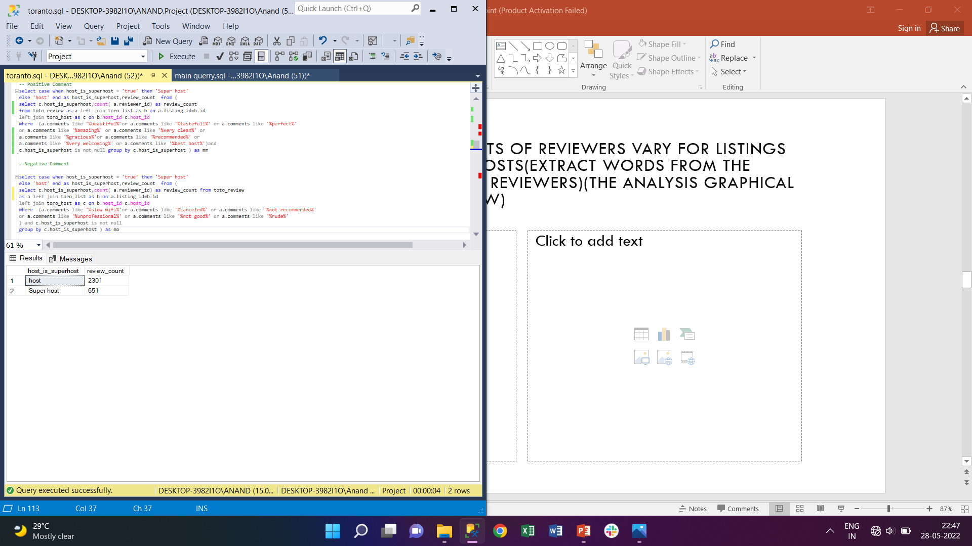
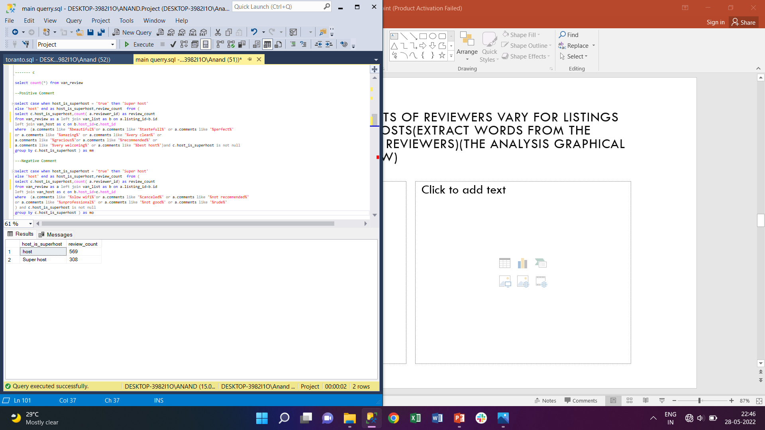
Negative Comment Toronto
Negative Comment Vancouver

Slide 13
Graphical Representation
There are total 400886 comment for Toronto city hosts (Both) and total 164536 Comment For Vancouver City Hosts (Both).
The Number of positive comments for Toronto City Super Host Are 80049 and host are 66814
The number of positive comments for Vancouver City Super Host Are 42145 and host are 20276
The Number OF Negative Comments For Toronto City Super Host is 651 which is very less as compared to host count i.e., 2301
The Number OF Negative Comments For Vancouver City Super Host are 308 which only half as compared to host count i.e., 569

Slide 14
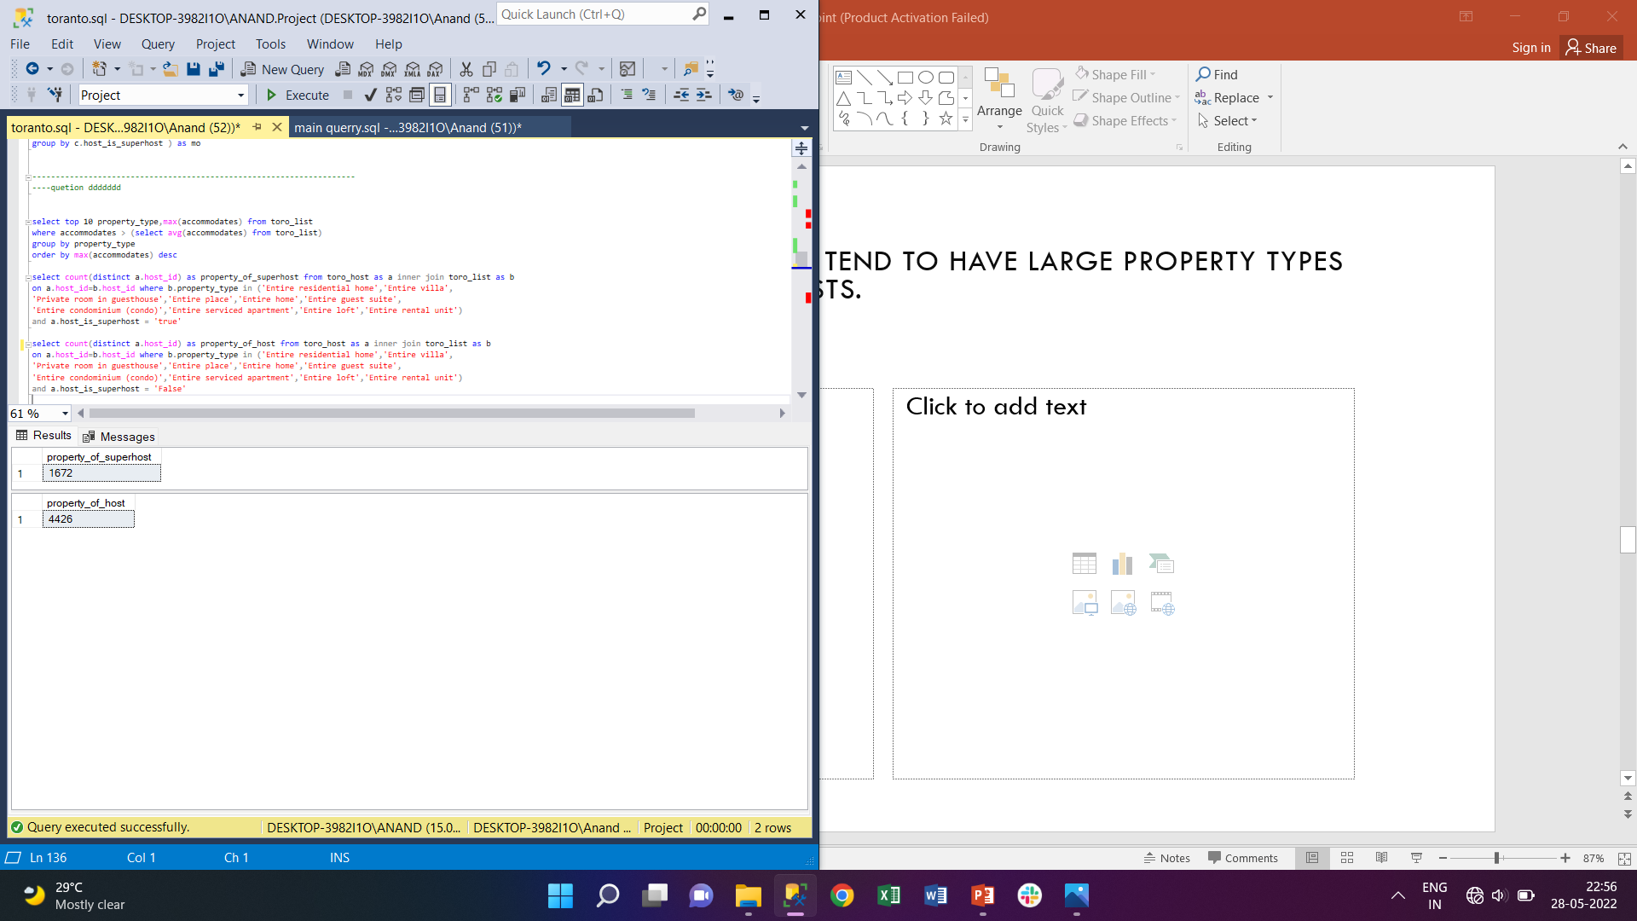
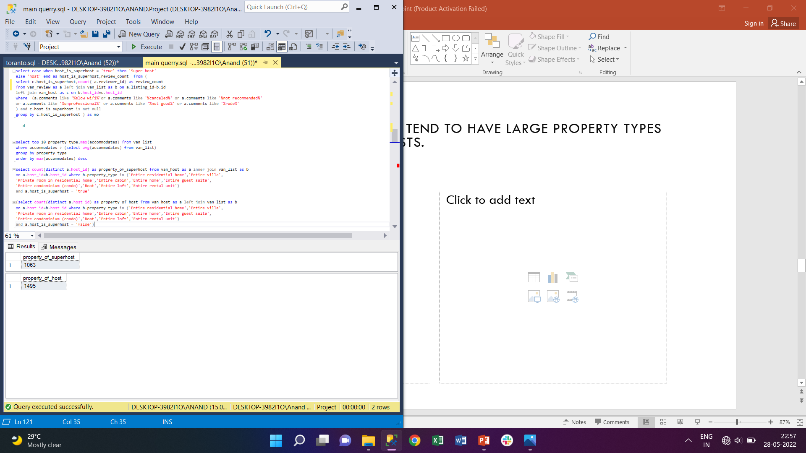
d. Analyse do Super Hosts tend to have large property types as compared to Other Hosts.
Large Property Toronto
Large Property Vancouver

Slide 15
Graphical Representation
→ Analysis Done on basis of Accommodation → Top 10 property type having Accommodation greater than Average accommodation are considered. Entire residential home, Entire villa, Private room in residential home, Entire cabin, Entire home, Entire guest suite, Entire condominium (condo),Boat, Entire loft, Entire rental unit property type are considered
→In Vanocur 1063 Super host 1495 host have large property →In Toronto 1063 Super host 4426 host have large property
Vancour |  | Toronto
Super host | host | Super host | host
1228 | 1898 | 2353 | 7616

Slide 16
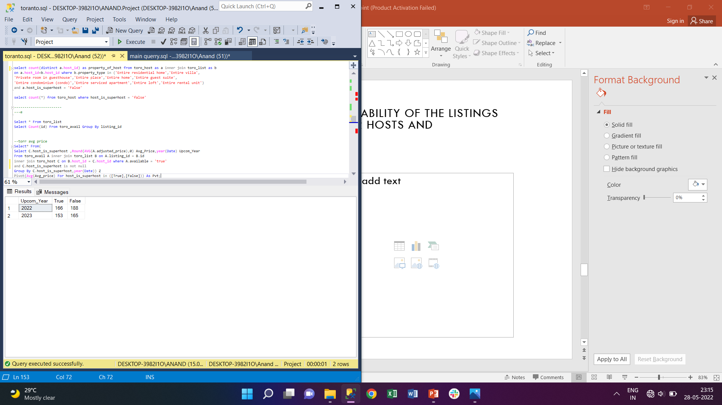
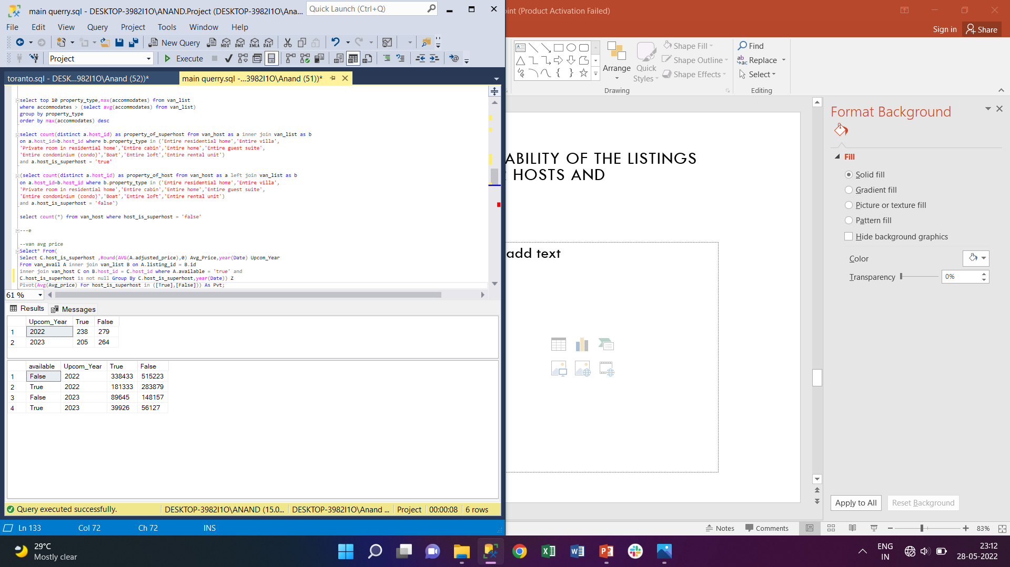
e. Analyze the average price and availability of the listings for the upcoming year between Super Hosts and Other Hosts
Average Price Upcoming Year Toronto
Average Price Upcoming Year Vancouver

Slide 17
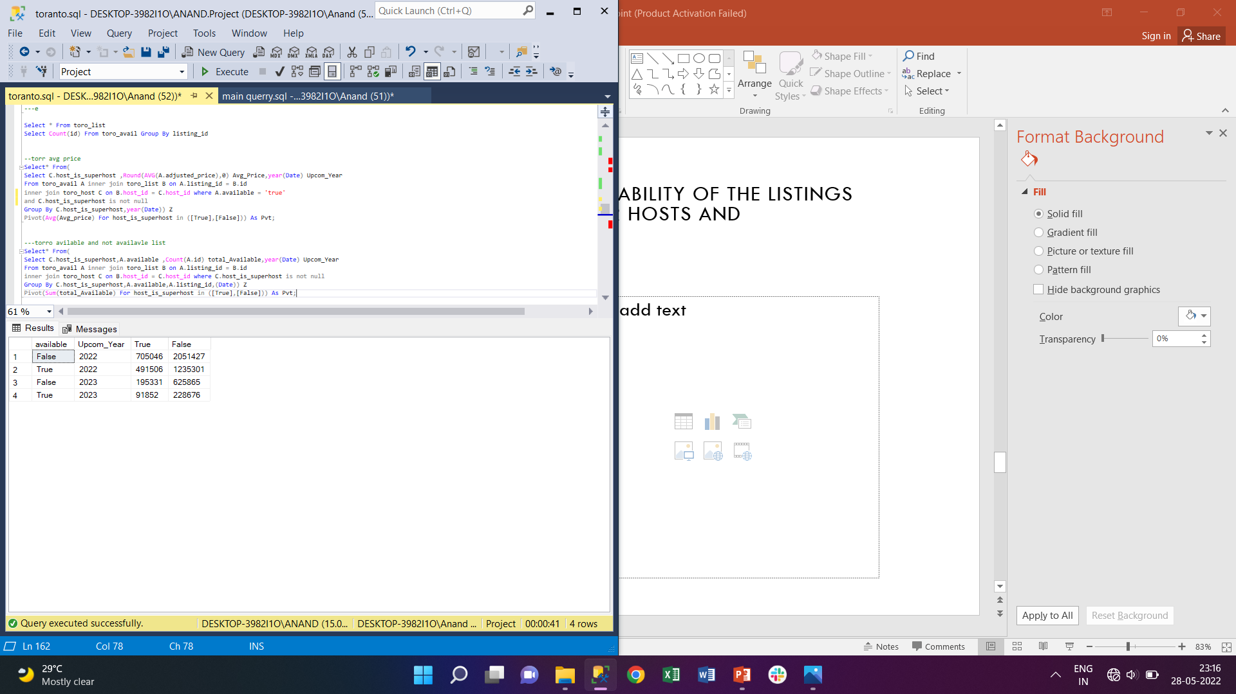
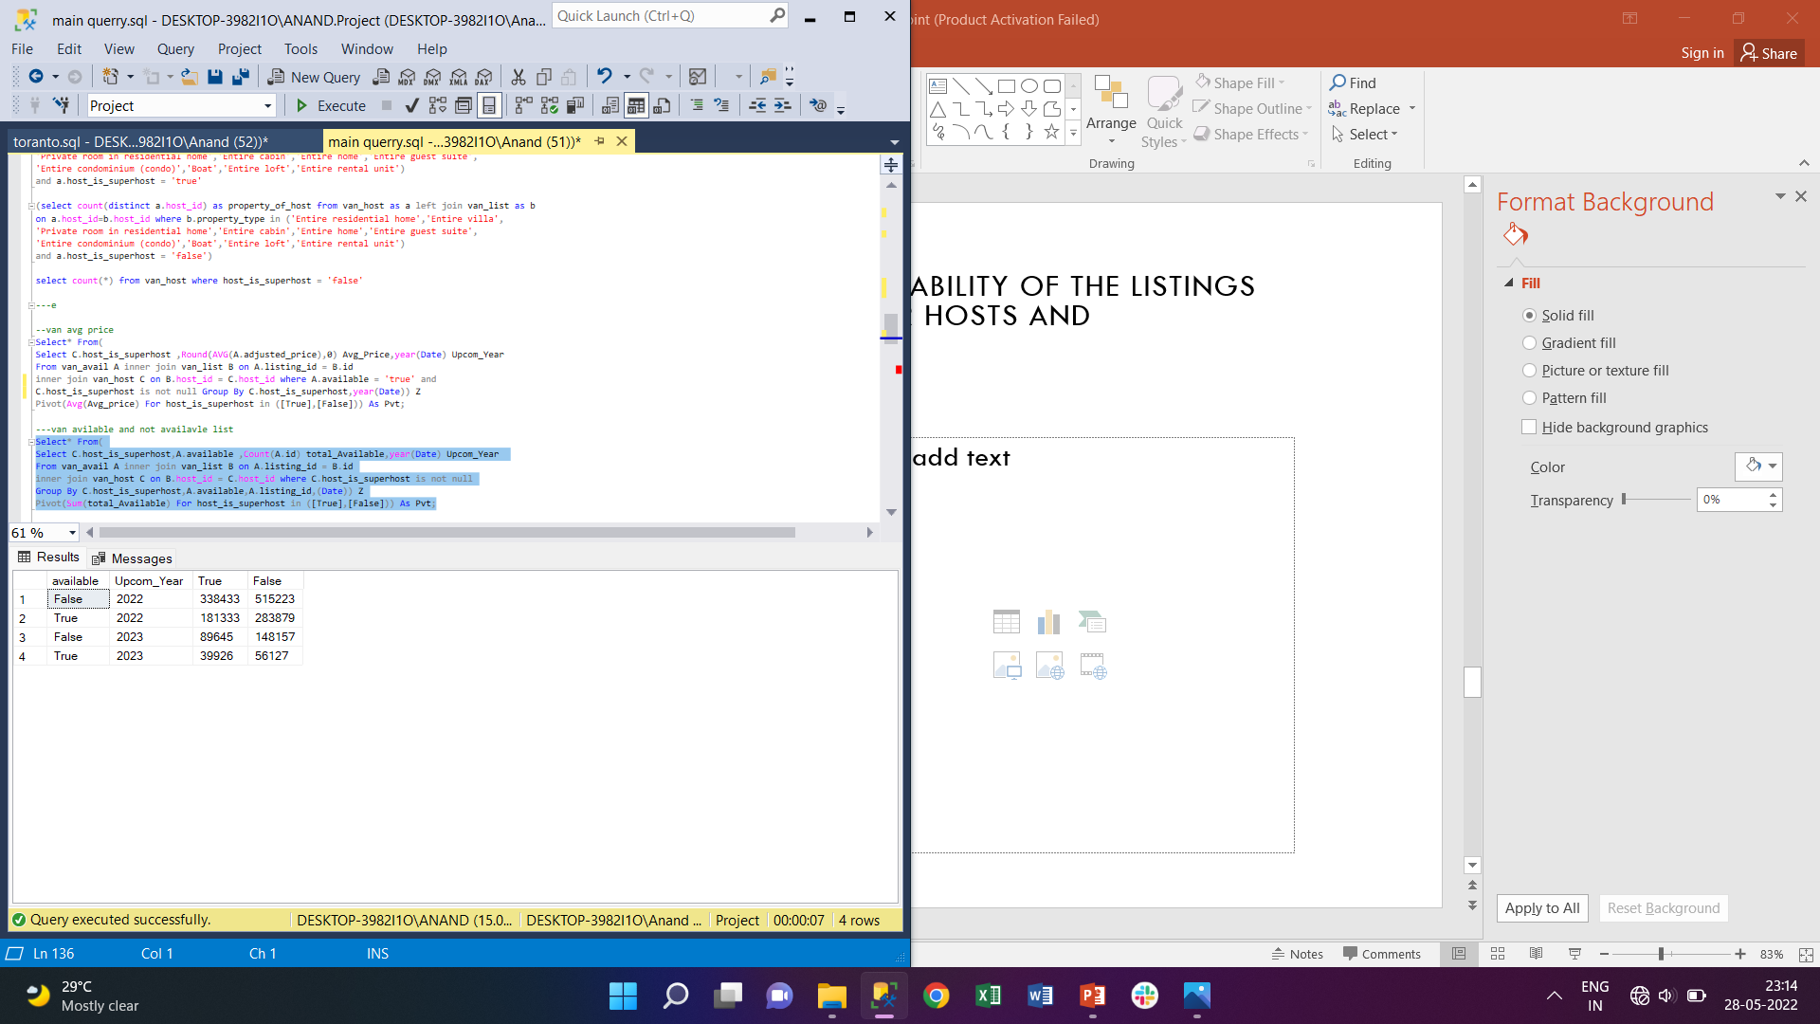
Availability of Listings Upcoming Year Toronto
Availability of Listings Upcoming Year Vancouver

Slide 18
Graphical Representation
→ Average Price for upcoming year are greater for host in both years → number of hotels available and not available were high for host than super host in both cities.
→% availability Present year
→% availability Upcoming year
City | super host | host
Toronto | 41.1% | 37.6%
Vancouver | 34.9% | 35.5%
City | super host | host
Toronto | 32.0% | 26.8%
Vancouver | 30.8% | 27.5%

Slide 19
f. Analyze if there is some difference in above mentioned trends between Local Hosts or Hosts residing in other locations
Local hosts → host whose neighbour location is same as listing neighbour following comparison were made between local host and other host

Slide 20
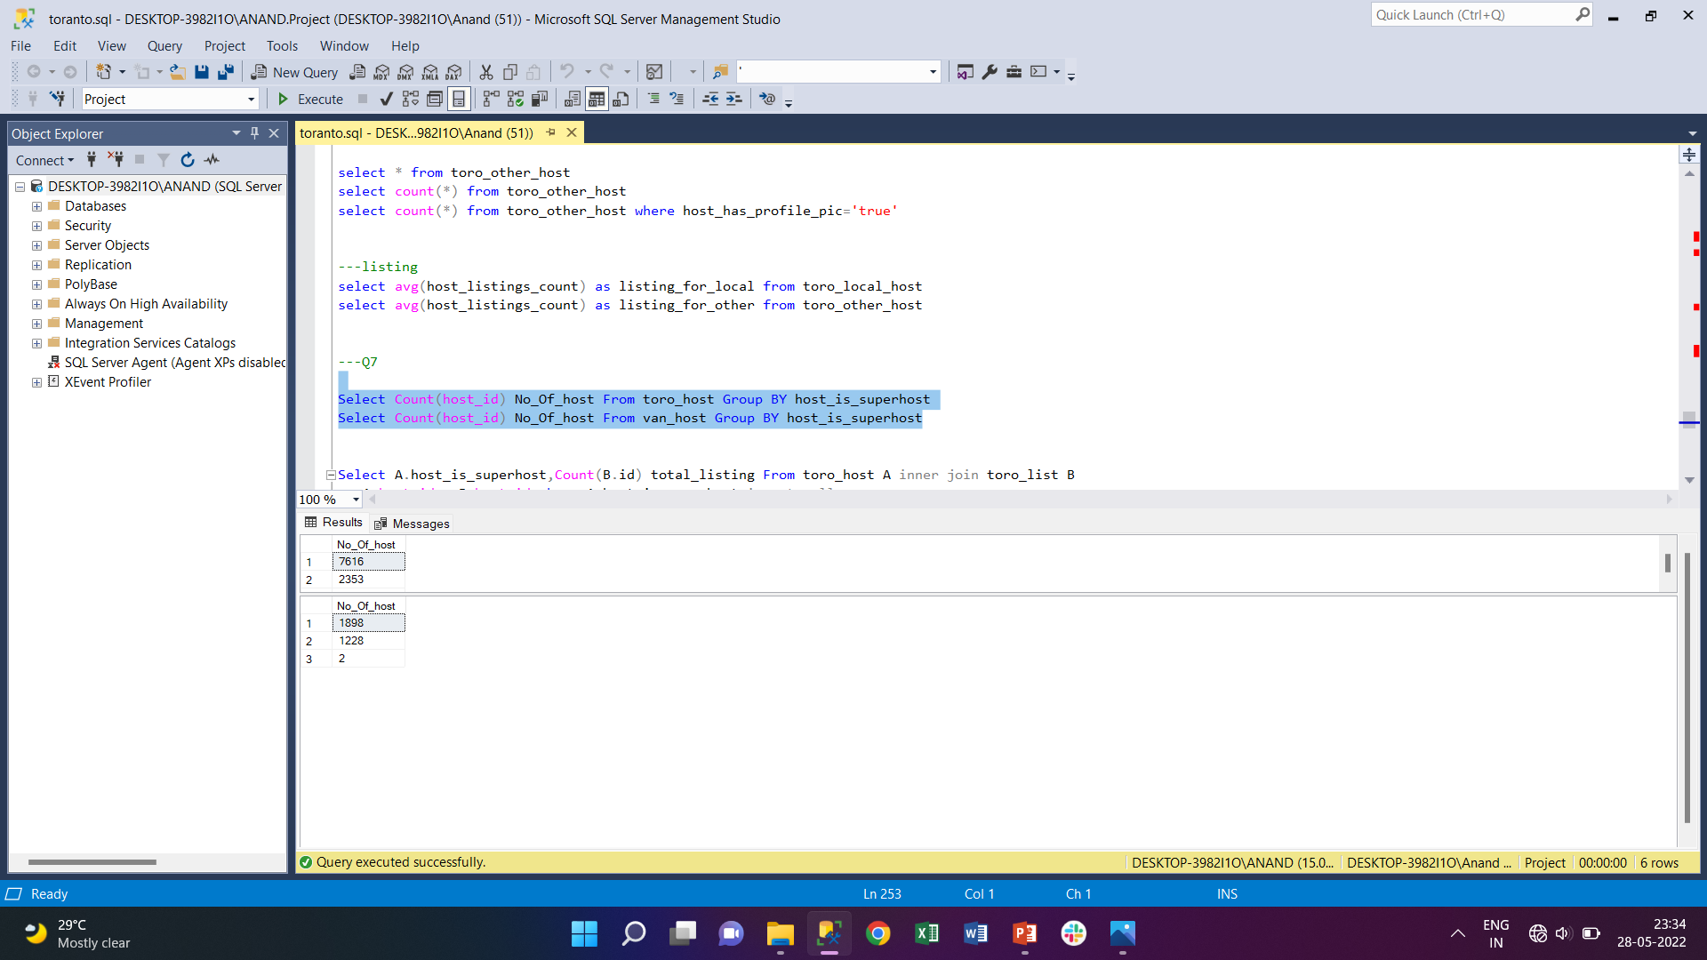
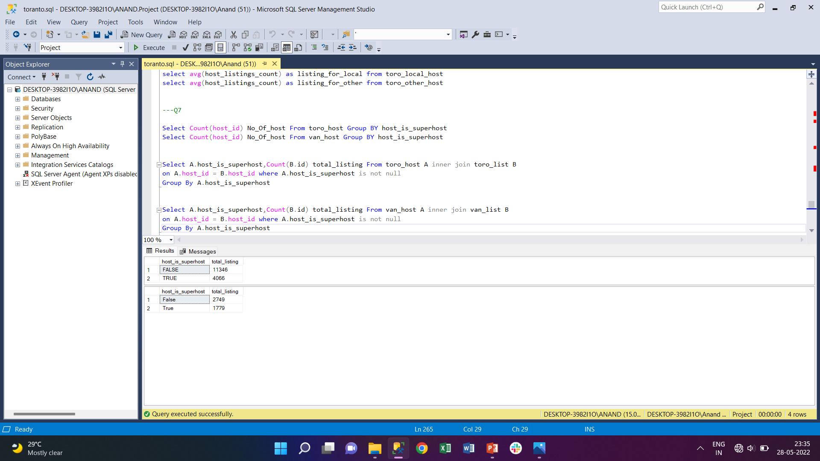
G. Analysis of the trends for the two cities for which data has been provided
Total Host And superhost between two cities
Total Listinng between two cities

Slide 21
Graphical Representation

Slide 22


Thank you!

